Slide 1


Retrofitting Operating System Security for Modern Hardware Protections
Kha Dinh Duy
Sungkyunkwan University
Department of Computer Science and Engineering
System Security Lab

Slide 2

Outline
Introduction
Background
Thesis work: Capacity
Thesis work: IncognitOS
Conclusion

Slide 3
Introduction

Slide 4
OS Protection
Operating Systems (OSes) underpin modern system security
OSes enforce a protection* system to control access between subjects and objects
Access control matrix
 | Log files | Accounting files | Public files
Alice | read,write |  | read, write
Bob | - | write | read,write
*Butler W. Lampson. 1974. Protection. SIGOPS Oper. Syst. Rev. 8, 1 (January 1974)

Slide 5
Modern Hardware Protection
Modern hardware introduces features addressing limitations of OS protection, often outside of OS responsibilities
Need for finer-grained Isolation → In-process memory isolation primitives (e.g., Intel PKU, ARM MTE)
Trusted execution → Hardware Trusted Execution Environments (e.g., Intel SGX, AMD SEV)

Slide 6
How do we retrofit modern hardware for security safely and efficiently?

Slide 7
What can go wrong?
Ad hoc security retrofitting can offset security & performance benefits provided by hardware.
Examples:
Kernel confused deputy attacks on in-process isolation systems
Interface and side-channel attacks on trusted execution environments
We will revisit them later

Slide 8

Problem: Protection Inconherencies
“A chain is only as strong as its weakest link”
Gaps in hardware-defined and OS protections reveal attack vectors.
Protection Gap

Slide 9
How do we achieve coherence in security retrofits?

Slide 10
This Thesis
Retrofiting OS
for hardware protection
[Oakland ‘25]
Retrofiting hardware
isolation into OS
protection [CCS ‘23]
IncognitOS:
Retrofiting OS
for hardware CVM
Protection [Oakland ‘25]
Capacity:
Retrofiting hardware
isolation into OS
protection [CCS ‘23]
Hardware-defined protection
OS protection

Slide 11
This Thesis
Capacity:
Retrofiting hardware
isolation into OS
protection [CCS ‘23]
IncognitOS:
Retrofiting OS
for hardware CVM
Protection [Oakland ‘25]
Retrofiting hardware
isolation into OS
protection [CCS ‘23]
Retrofiting OS
for hardware protection
[Oakland ‘25]
Hardware-defined protection
OS protection

Slide 12
This Thesis
Capacity:
Retrofiting hardware
isolation into OS
protection [CCS ‘23]
IncognitOS:
Retrofiting OS
for hardware CVM
Protection [Oakland ‘25]
Retrofiting hardware
isolation into OS
protection [CCS ‘23]
Retrofiting OS
for hardware protection
[Oakland ‘25]
Coherence is critical for safety and efficiency when retrofitting modern hardware security features!
Hardware-defined protection
OS protection

Slide 13
Background

Slide 14
Limitations of OS Protection
OS-provided protection is no longer sufficient in the modern age
Individual programs are increasingly complicated → need for fine-grained isolation
Trust crisis in the cloud → need to rethink system trust model

Slide 15
Need for Isolation
Principle of least privilege: Software should be divided into least-privilege components (or domains)
Resource
Component A
Resource
Monolithic software
Component B
Resource
Resource
Component C
Resource

Slide 16
Limitations of Process Isolation
OSes enforce isolation at process granularity
Used in many modern software (web browsers, OpenSSH), but…
High engineering/ development costs
High costs of Inter Process Communication (IPC)
Proc. 1
IPC
Proc. 2
IPC
Proc. 2
system calls
Operating System

Slide 17
In-process Isolation Primities
Modern hardware establishes in-process memory protection
Intel Protection Keys for Userspace
ARM Memory Tagging Extension (MTE)
Capability Hardware Enhanced RISC Instructions (CHERI)

Slide 18

HW-assisted In-process Isolation
Divide a process into sub-process domains
Limiting blast radius of software bug in one domain
Process Memory space
X
Crypto
Math
Network
Math
Util
In-process domains

Slide 19
Limitations of OS Protection
OS-provided protection is no longer sufficient in the modern age
Individual programs are increasingly complicated → need for fine-grained isolation
Trust crisis in the cloud → need to rethink system trust model

Slide 20
Need for trust in cloud
OS protection isolates applications from each other
And isolates applications from the OS. But …
Sensitive Computation
X
Malicious App
OSes expose huge attack surfaces (millions of LoC)
Insider attacks: cloud provider can install malicious OSes
X
Operating System
Operating System
Malicious admins

Slide 21
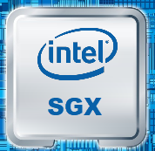
Hardware Trusted Execution
Intel SGX (2015) establishes hardware-protected secure enclaves with strong isolation and memory encryption
Enclave
Require rewriting/adopting existing workloads
Did not gain widespread adoption
X
Malicious App
X
X
OS
Hypervisor
Hardware
Root of Trust

Slide 22

Hardware Confidential VM (CVM)
Confidential Virtual Machines (CVM), e.g., AMD SEV, Intel TDX, ARM CCA, bring entire VM (OS + applications) into protection
CVM
Application
Excellent compatibility with existing/cutting-edge cloud workloads (e.g., AI inferences)
Malicious VMs
OS
Hypervisor
Hardware
Root of Trust

Slide 23
Summary: Trends in HW Protection
Confidential Virtual
Machines
In-process Isolation
Process
Process
App
OS
OS
Hypervisor
Process
App
OS
Compartments
OS
Hypervisor

Slide 24
Summary: Trends in HW Protection
Confidential Virtual
Machines
In-process Isolation
Process
Process
App
OS
OS
Hypervisor
Process
App
OS
Compartments
OS
Hypervisor

Slide 25
Summary: Trends in HW Protection
In-process Isolation
Process
Process
OS
Process
Compartments
OS

Slide 26
Capacity: Cryptographically-Enforced In-Process Capabilities for Modern ARM Architectures

Slide 27
Confused Deputy Challenge
Process Memory space
X
Crypto
Math
Network
Math
Util
In-process domains
system calls
Files
Sockets
Memory
Mappings
Operating System

Slide 28
Confused Deputy Challenge
Process Memory space
X
Crypto
Math
Network
Math
Util
The OS becomes a confused deputy
In-process domains
system calls
Files
Sockets
Memory
Mappings
Operating System

Slide 29
Root cause: Incoherence
Incoherences between OS and hardware protection:
  OS protection cover all system resources
  Hardware-defined protection only protect memory
Attacks on syscall interface
Hardware-defined protection
OS protection

Slide 30
Capacity Research Statement
Approach: Coherent abstraction design
Capacity explores a capability-based in-process isolation design inspired by the direction of new hardware security in modern ARM architecture
Hardware-defined protection
OS protection

Slide 31
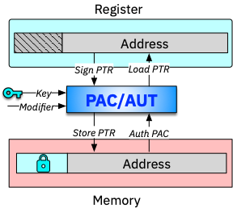
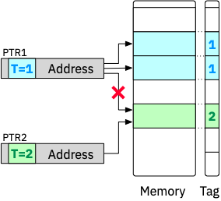
New Hardware Features on ARM
Pointer Authentication (PA)
Memory Tagging Extension (MTE)

Slide 32
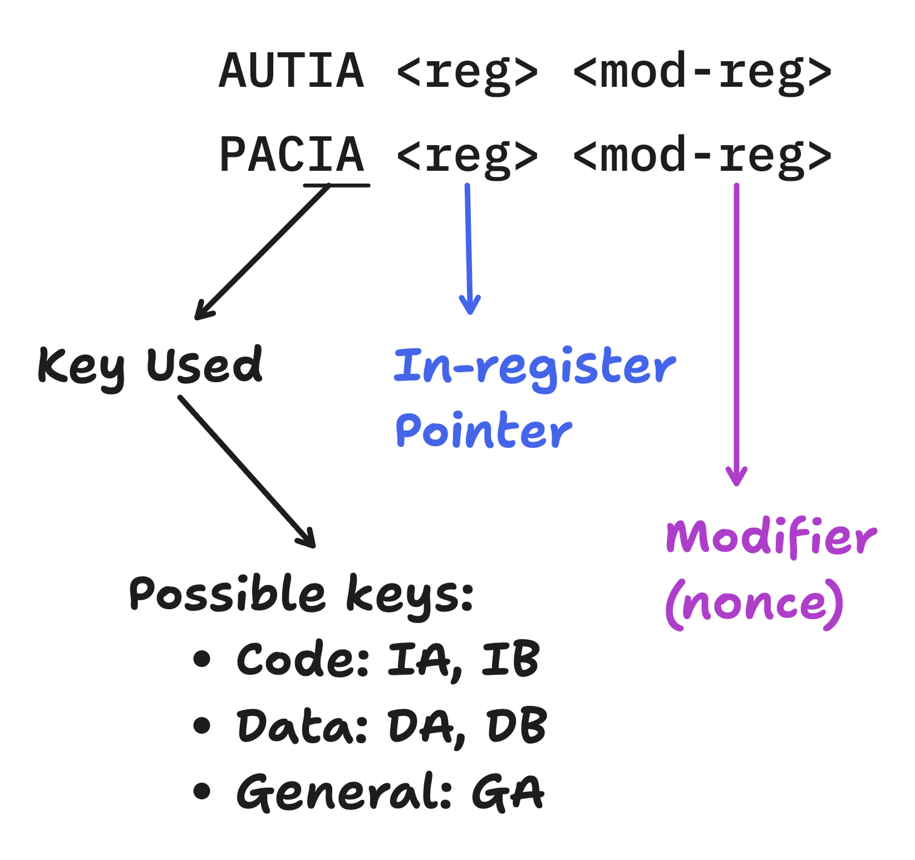
Pointer Authentication

Slide 33
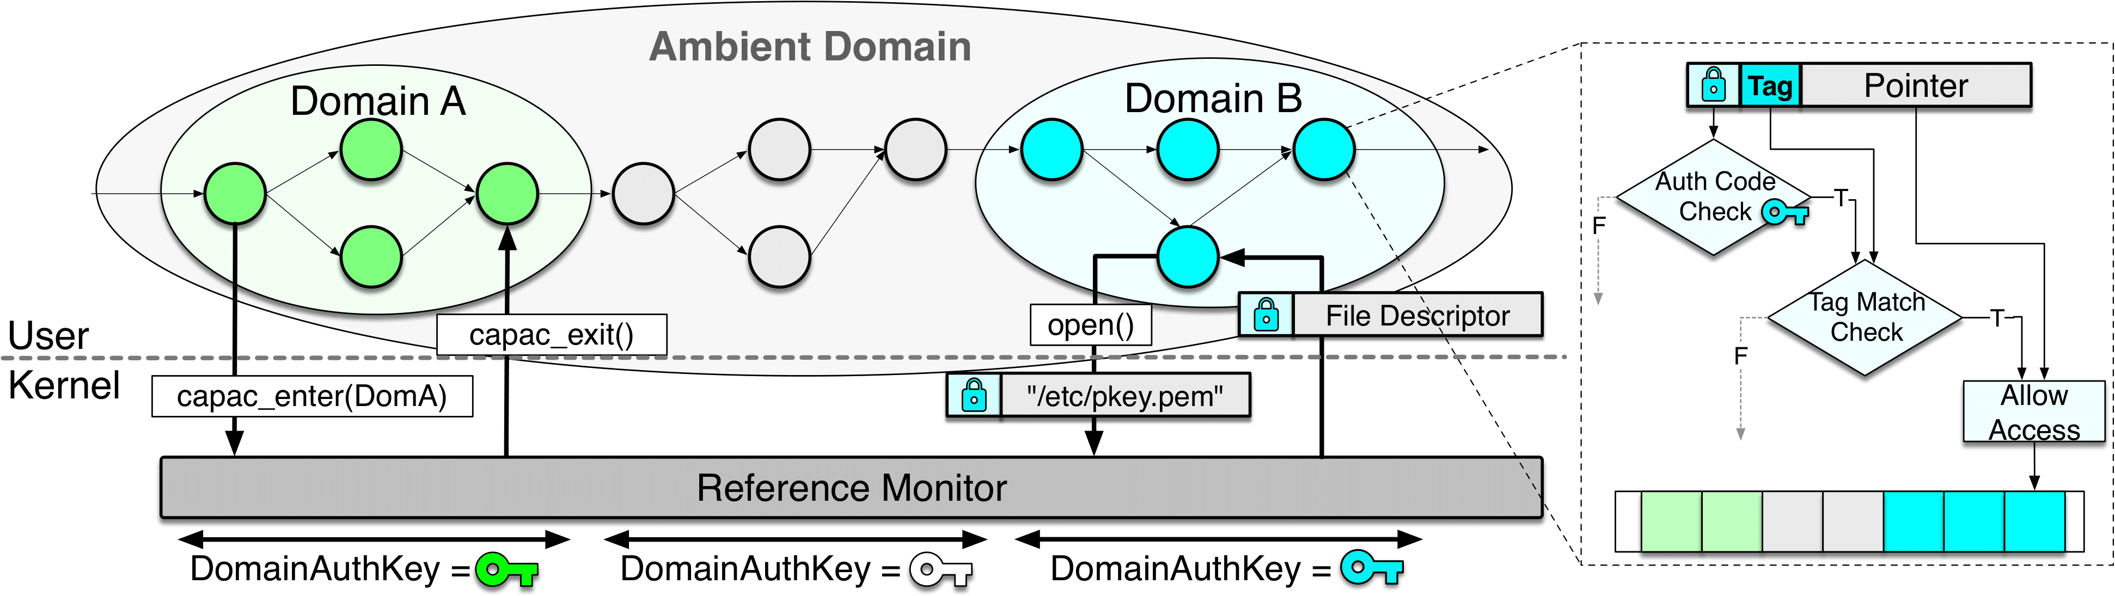
Capacity Overview
Program resource handles (pointers, file descriptors)
Cryptographically-authenticated references (Capabilities)
Socket 1
Socket 1
0xdeadbeef
0xdeadbeef
STDIN
0xcafebabe
0xcafebabe
STDIN

Slide 34
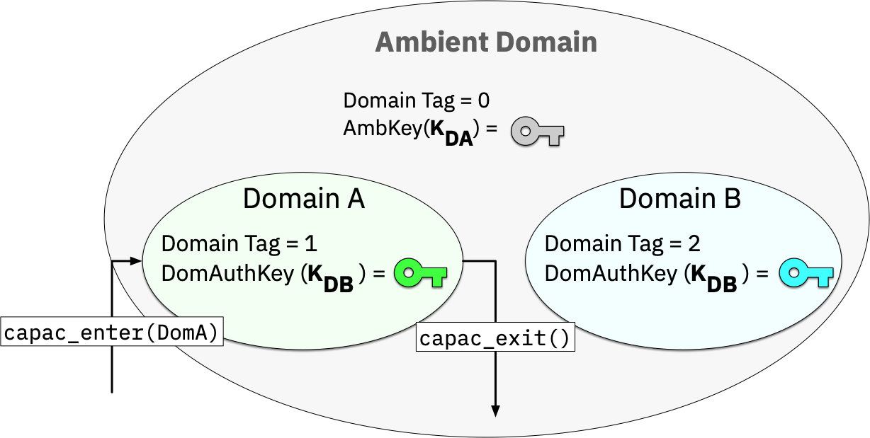
Capacity Domains

Slide 35
Domain-private vs Ambient Ref.
A’S Domain Private Key
Ambient Key
Process Resources
Memory Obj 1
File A
File B
Memory Obj 2
X
X
X
AUTH( )
SIGN( )
AUTH( )
SIGN( )
A’s Ref.
A’s Ref.
Amb. Ref
Amb. Ref
Domain-private
Reference
Ambient
References

Slide 36
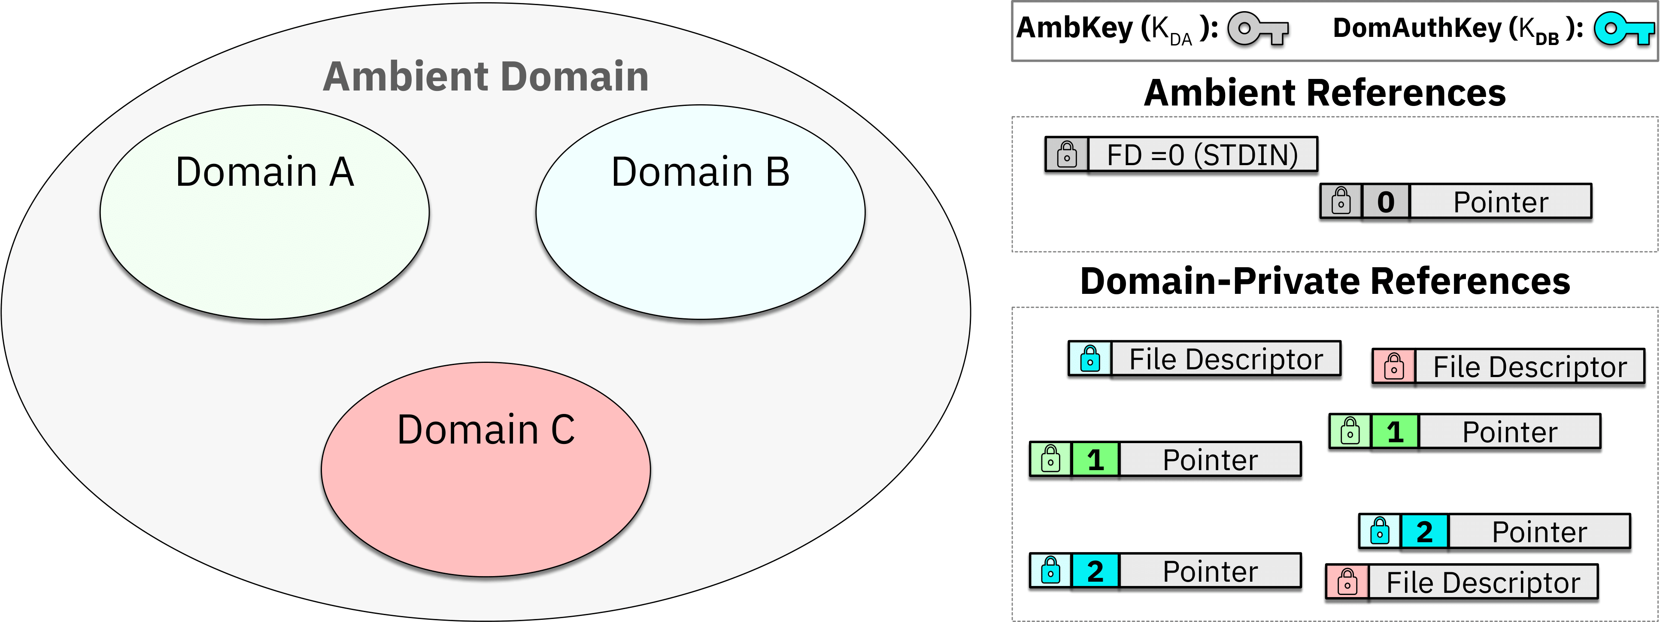
Domain Transition in Action

Slide 37
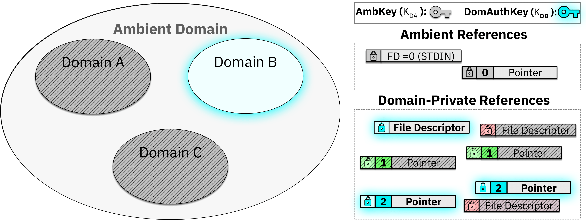
Domain Transition in Action

Slide 38
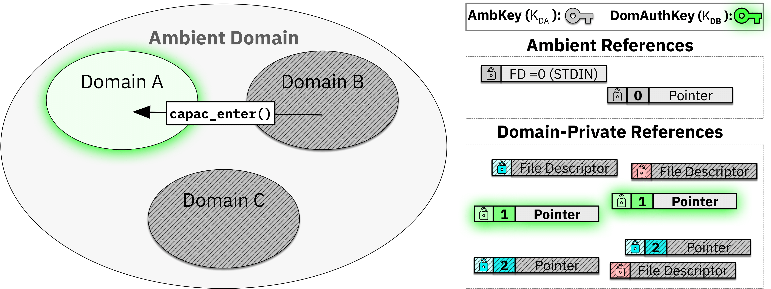
Domain Transition in Action

Slide 39
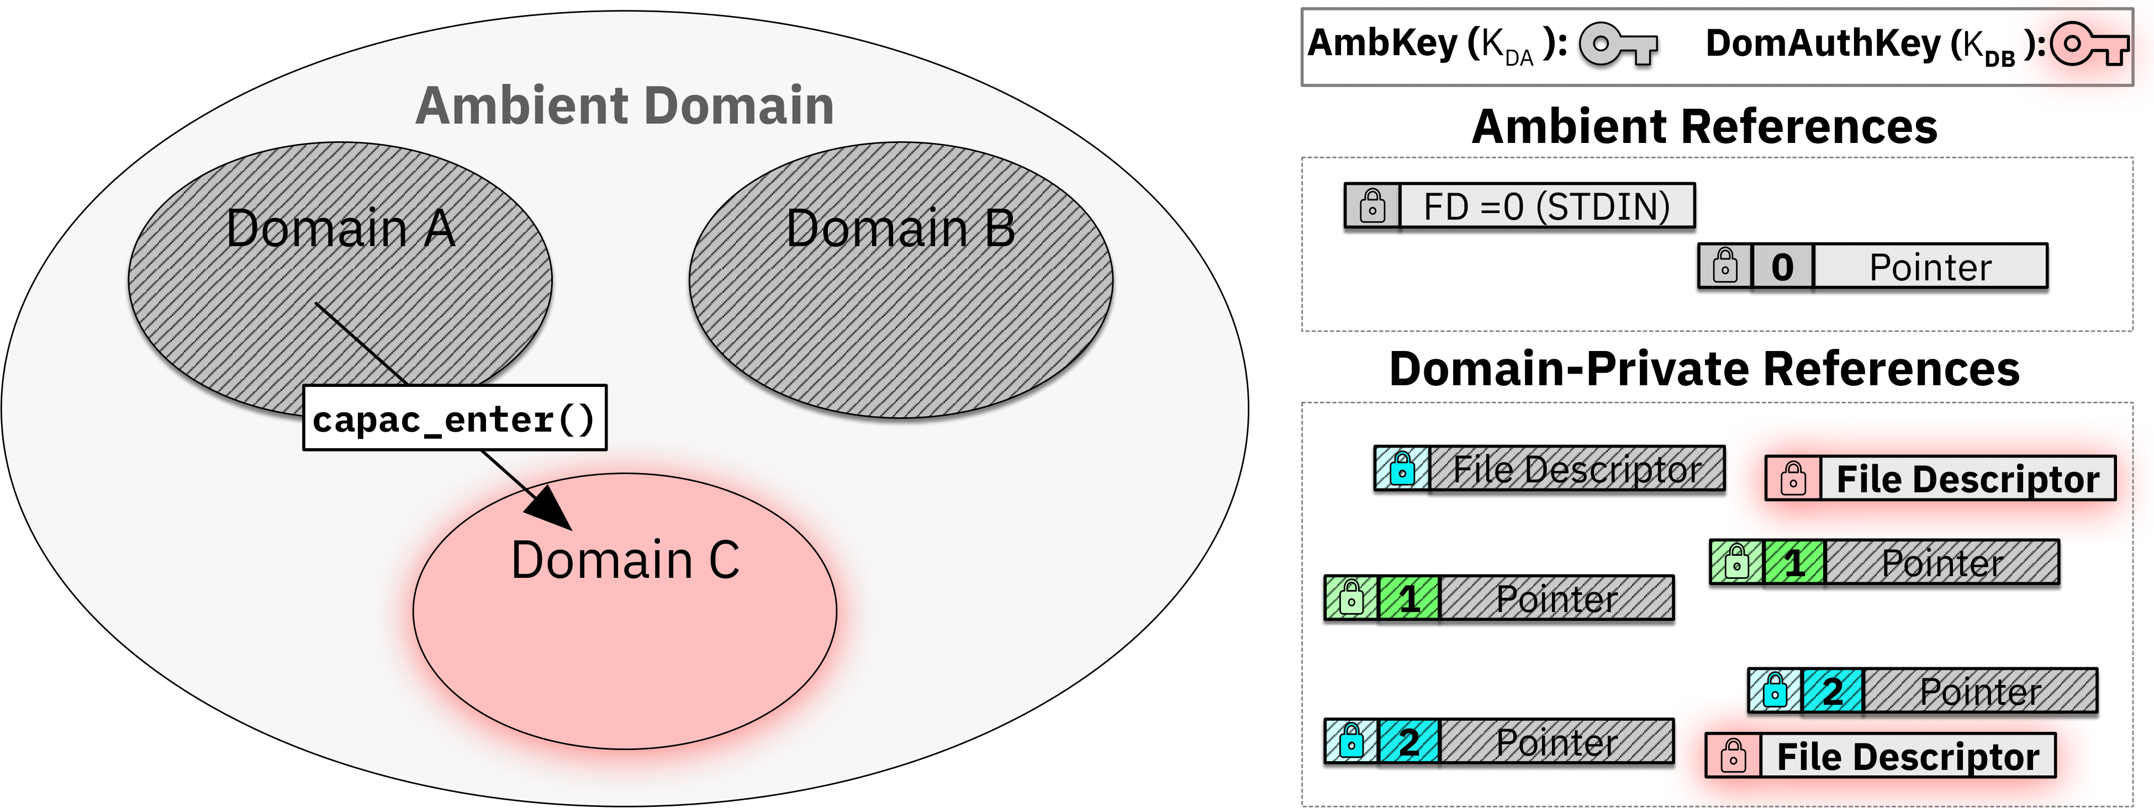
Domain Transition in Action

Slide 40
Implementing Capacity
In-kernel Reference monitor for authenticating system references
Compiler instrumentation & memory allocator for authenticating memory references

Slide 41
Implementing Capacity
Coherent & lightweight: All resource references are signed/authenticated with a single hardware-accelerated instruction

Slide 42













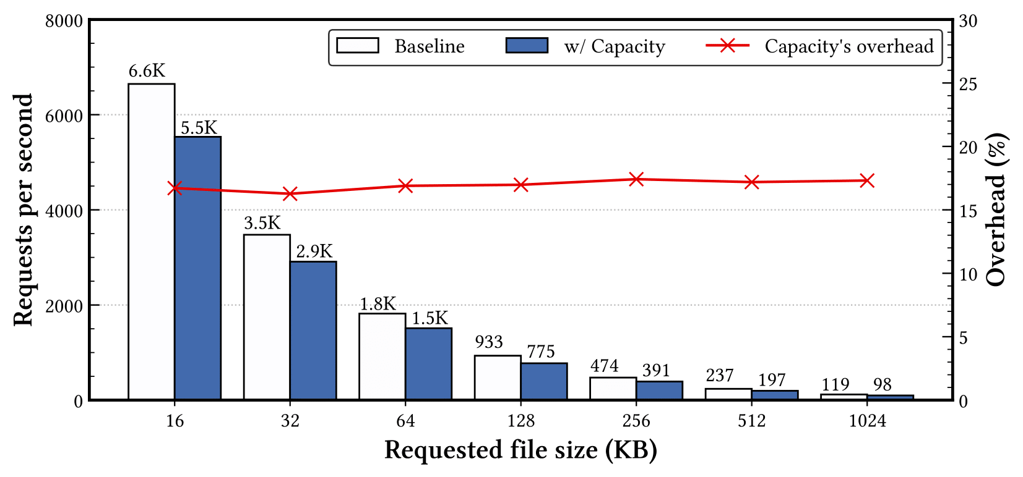
Capacity’s Overheads on NGINX
DOM_HANDSHAKE
DOM_SESSION [5]
Encrypt/Decrypt Packets
Open Private Key File
Load Private Key File
TLS Handshake
PrivKey
PrivKey
FD
PrivKey
PTR
Session Key
PTR
Delegate
Session Key
PTR
PATH
Capacity incurs about 17% overheads on privilege-separated NGINX web server

Slide 43
Confidential Virtual
Machines
In-process Isolation
Process
Process
App
OS
OS
Hypervisor
Process
App
OS
Compartments
OS
Hypervisor

Slide 44
IncognitOS: A Practical Unikernel Design for Full-System Obfuscation in Confidential Virtual Machines

Slide 45
Challenges for CVM Deployments
Bloated TCB: Millions of OS LoC are brought into the TCB
CVM
Application
System calls
Other utilities
OS
Malicious VMs
HW interfaces
Networking stack
Hypervisor
Hardware Root of Trust
Notes:
test

Slide 46
Side-channel Attacks on CVMs
Side-channel attacks were a significant challenge for Intel SGX and persist in CVMs
Ciphertext Attacks on SEV-SNP
[Cipherleak SEC '21, Relocate-Vote Sec '25]
Architectural states
CVM
SGX Controlled-channel attacks [Oakland '15]
Application
DRAM (Encrypted)
Malicious VMs
OS
SEV-SNP Controlled-channel attacks [Heckler SEC '24]
Host Page Table (Protected)
Microarchitectural states
SGX cache attacks [Woot '17]
Hypervisor
SEV cache attacks [SEV-STEP TCHES'24]
L1/L2/L3 Cache
Hardware Root of Trust
Branch predictor
SGX branch shadowing attacks [Woot '17]
???
Notes:
test

Slide 47
Toward Coherent OS Protection
As a TCB component, the OS itself must contribute to CVM protection
Explore OS designs for minimizing TCB
Mitigate side-channel attacks from guest OS vantage point
Side-channel attacks & bloated TCB
Hardware-defined protection
OS protection

Slide 48
IncognitOS Research Statement
Approach: Rethinking OS protection for hardware CVM protection (AMD SEV)
IncognitOS is a unikernel design for practical full-VM obfuscation of CVM workloads against side-channel attacks
Hardware-defined protection
OS protection

Slide 49
Unikernel Design
Reduced memory footprint (>10x reduction from microvms)
  feasible full-system memory access obfuscation
No user-kernel separation
  efficient accesses to hardware (MMU) and kernel subsystems

Slide 50
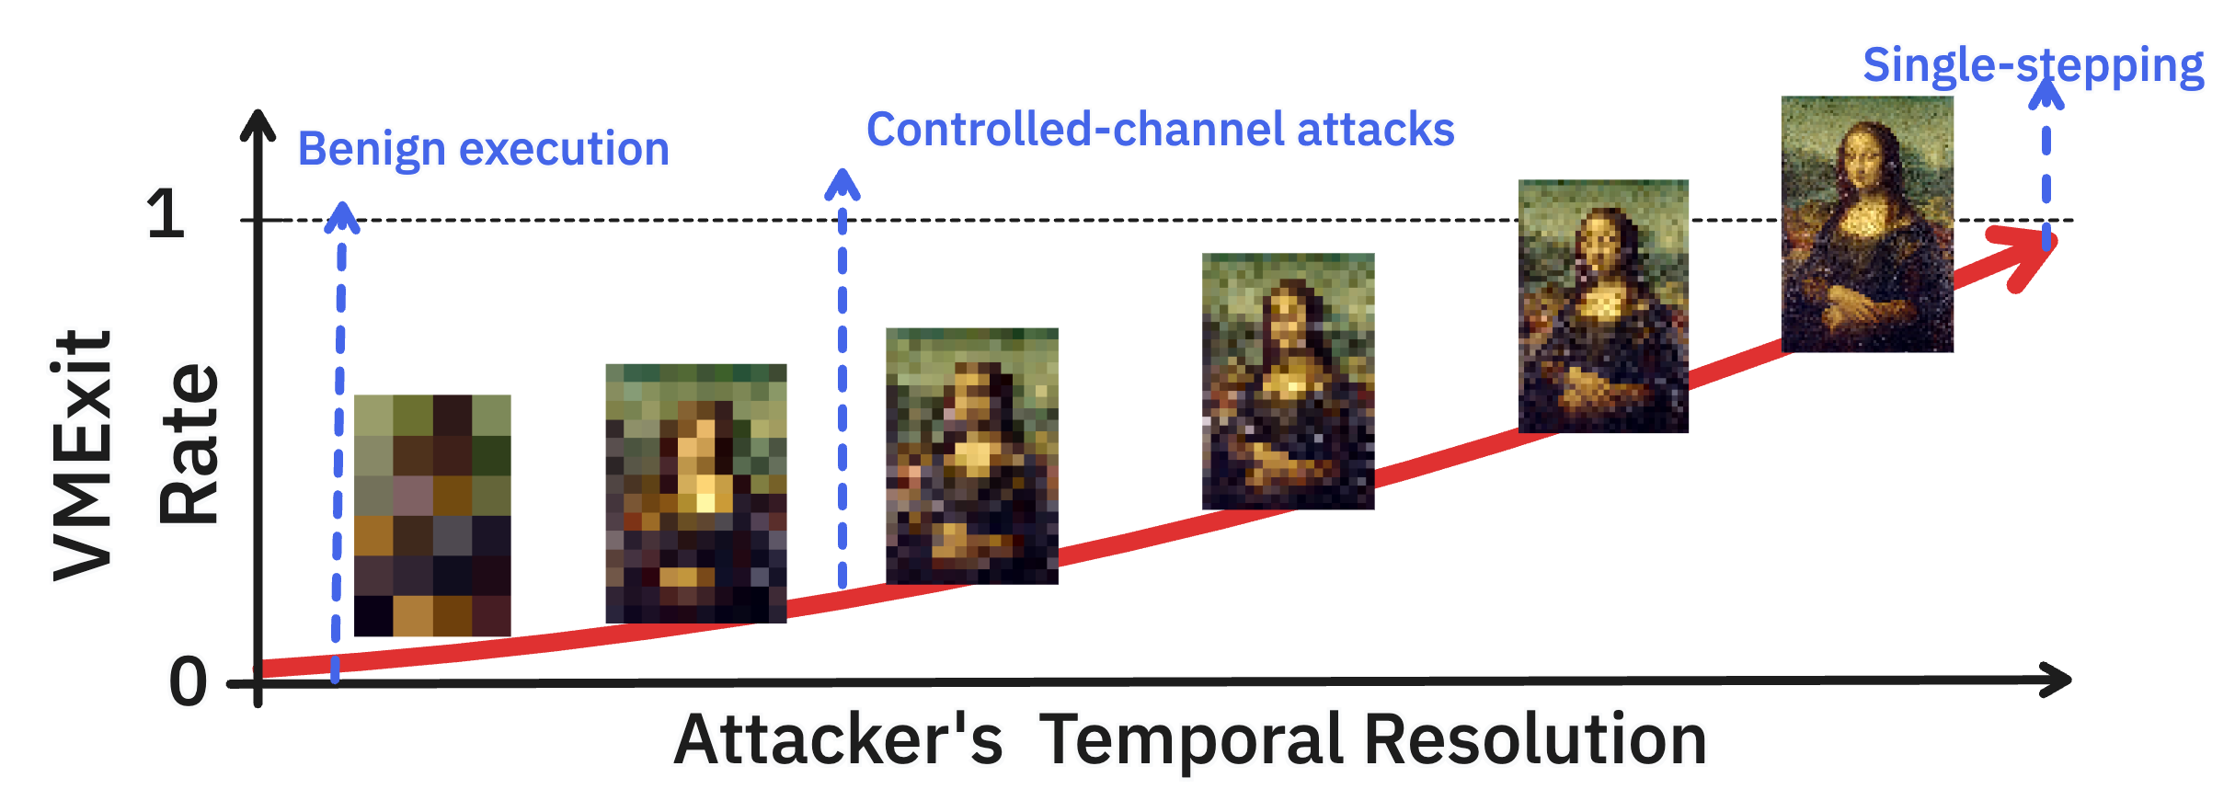
Adaptive Obfuscation
Key idea: Adapt memory randomization rate based on VMExit rate measurements

Slide 51
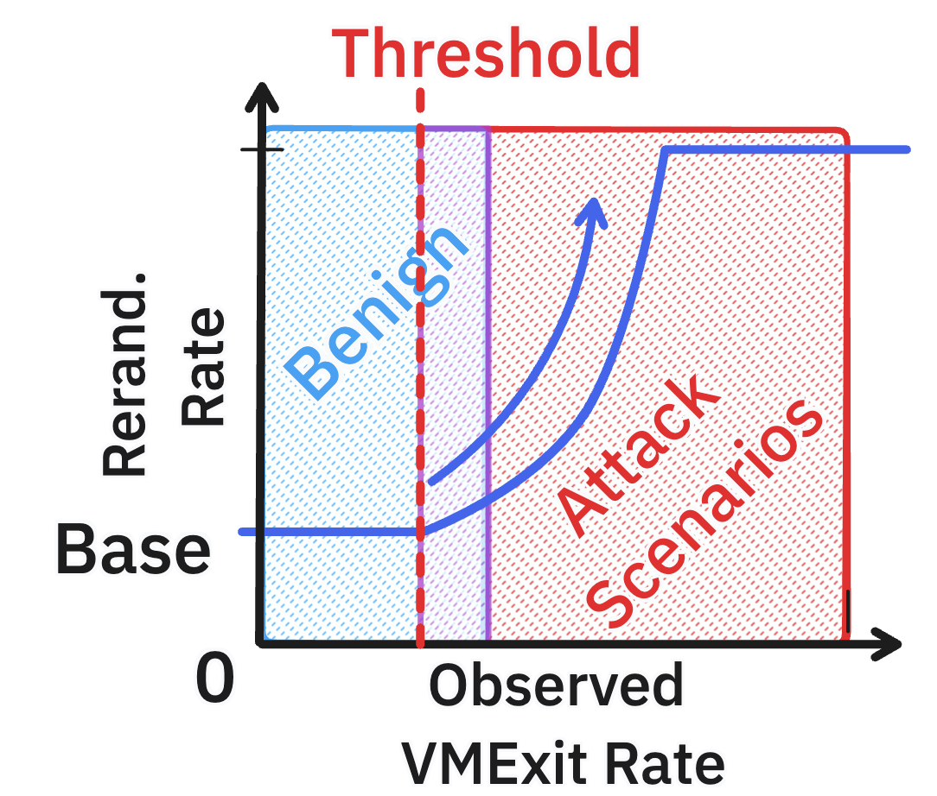
Adaptive Obfuscation
An immune system against side-channel attacks
🙂 Normal: Uses sane randomization rate & proactively looks for threats
😡 Threat detected: Schedules defense (rerandomizations) based on threat level

Slide 52
Retrofitting Kernel Subsystems
Scheduling
Samples current VMExit rate independently of
untrusted interrupts through static binary instrumentation
Paging
Transparently randomizes physical memory using OS-level access to hardware MMU

Slide 53
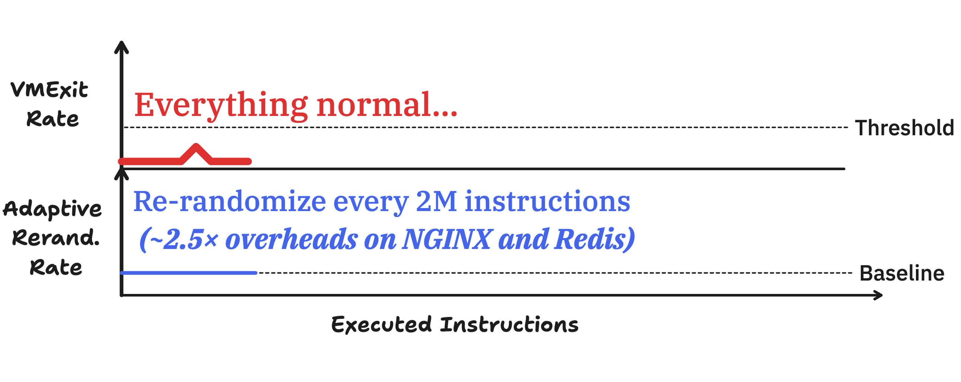
Adaptive Defense in Action

Slide 54
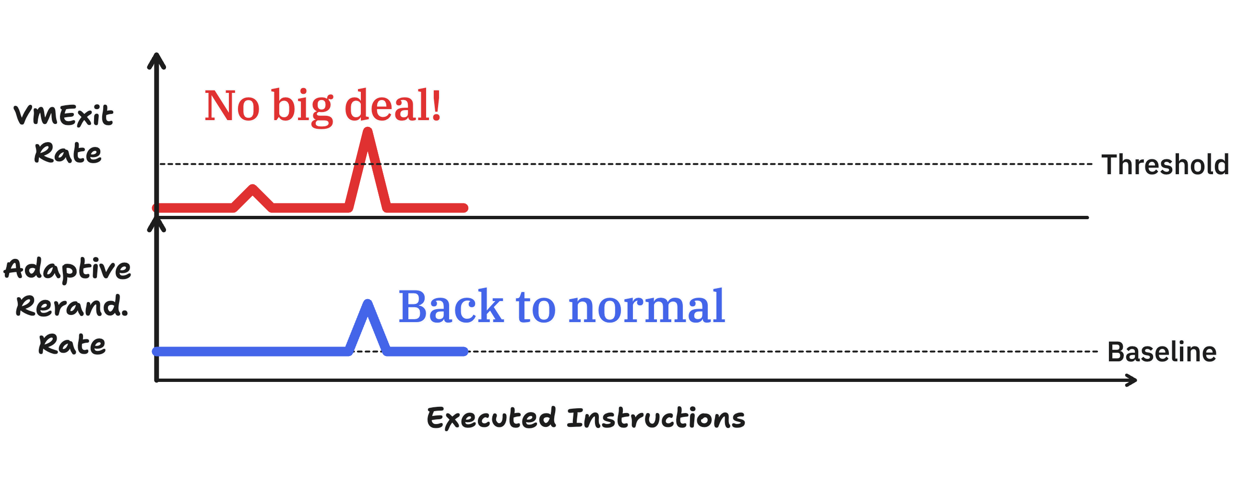
Adaptive Defense in Action

Slide 55
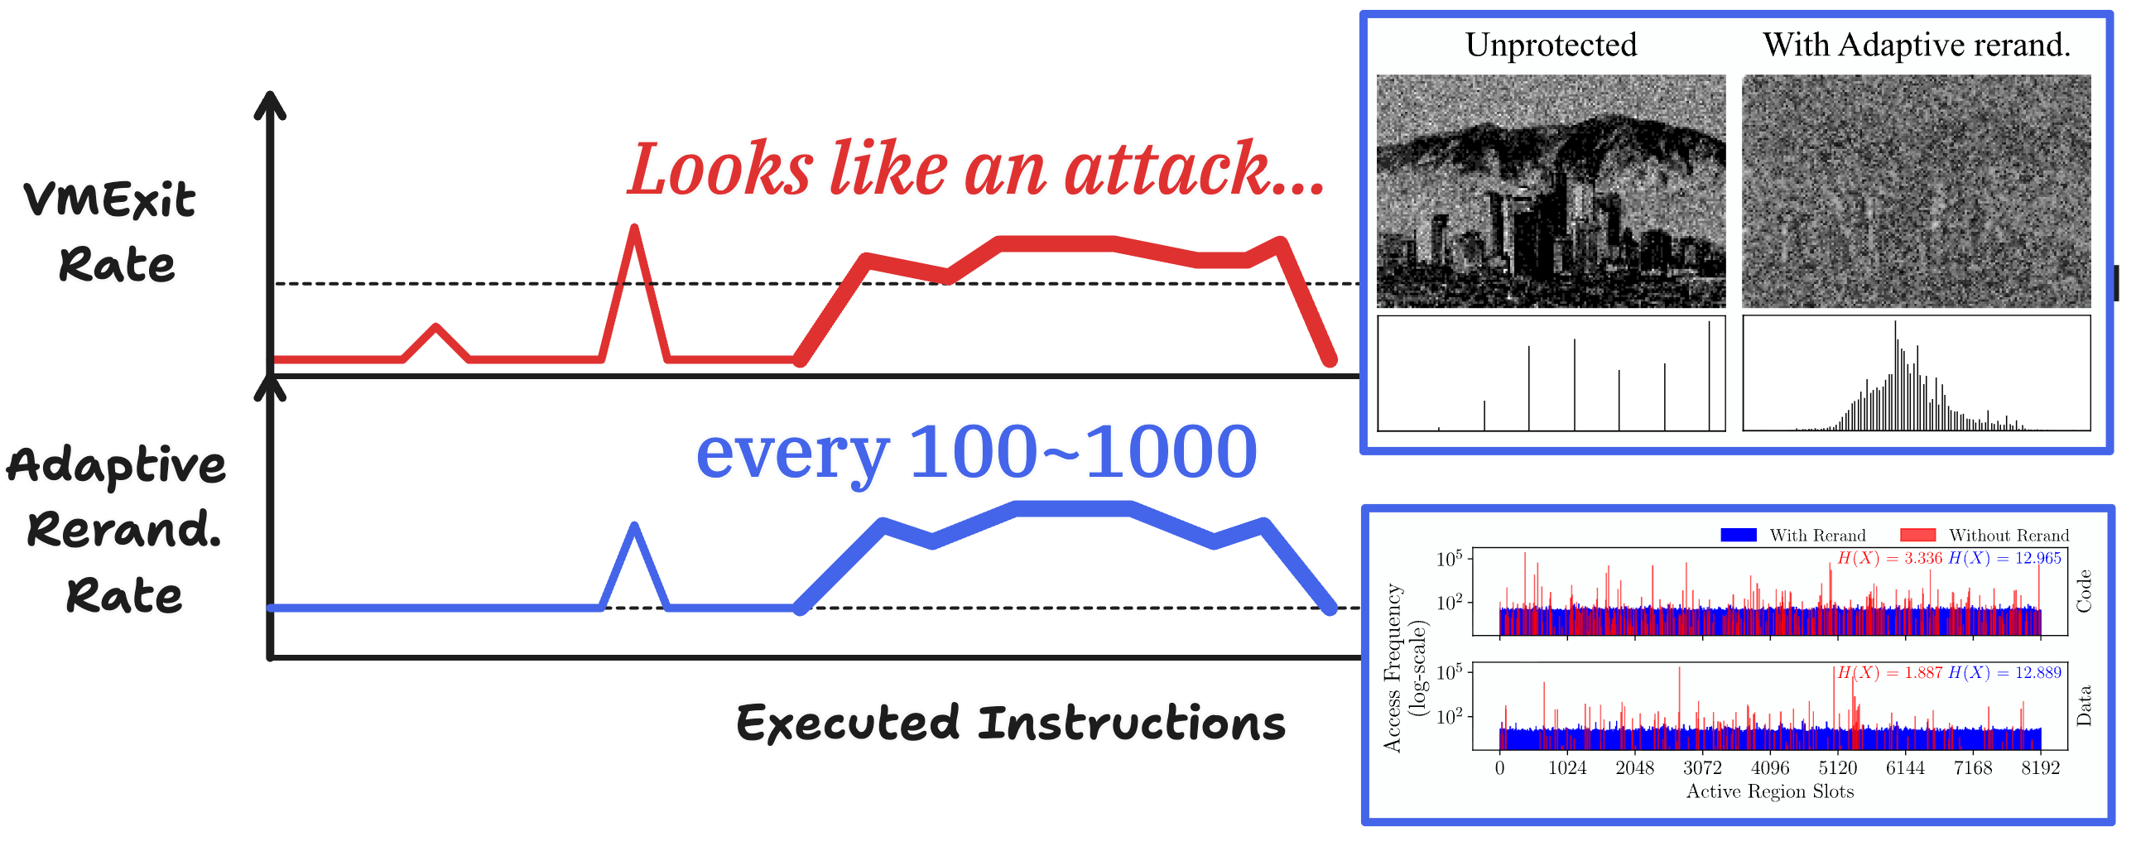
Adaptive Defense in Action

Slide 56
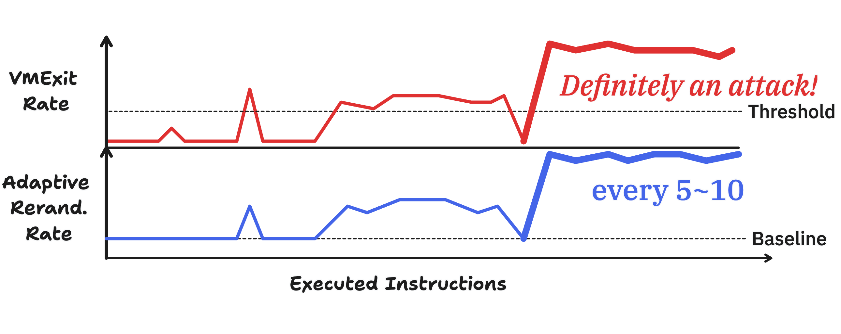
Adaptive Defense in Action

Slide 57
Summary
Retrofiting hardware
isolation into OS
protection [CCS ‘23]
Retrofiting OS
for hardware protection
[Oakland ‘25]
Hardware-defined protection
OS protection

Slide 58
Summary
Retrofiting hardware
isolation into OS
protection [CCS ‘23]
Coherence can be achieved through abstraction design
Retrofiting OS
for hardware protection
[Oakland ‘25]
Hardware-defined protection
OS protection

Slide 59
Summary
Retrofiting hardware
isolation into OS
protection [CCS ‘23]
Retrofiting OS
for hardware protection
[Oakland ‘25]
Coherence can be achieved through abstraction design
OS protection goals must also be rethought for coherence
Hardware-defined protection
OS protection

Slide 60
Conclusion
Modern hardware introduces protection mechanisms outside of OS responsibility
Hardware-defined protection must be coherent with the OS-defined one
Capacity and IncognitOS show coherence enables both safety and efficiency

Slide 61
Conclusion
Modern hardware introduces protection mechanisms outside of OS responsibility, introducing incoherencies
Hardware-defined protection must be coherent with the software (OS)
Capacity and IncognitOS show that that coherency enables for both safety and efficiency
Principle of coherent protection: Any new protection established with hardware must be coherent with the one established with software, and vice versa.

Slide 62
Q&A

Slide 63
Backup Slides

Slide 64
Software are increasingly complex
Modern web browsers contain over 30 million lines of code*
Third-party libraries and packages are common practice, e.g., NodeJS, OpenSSL, SQLite, ...
A single vulnerability anywhere conceeds control to attackers or expose systems secrets
*https://openhub.net/p/chrome/analyses/latest/languages_summary and
https://openhub.net/p/firefox/analyses/latest/languages_summary

Slide 65
Consequences of Complexity
Heartbleed vulnerability (CVE-2014-0160 ): A buffer-overread bug in OpenSSL affects hundreds of thousands of web servers
Supply chain attacks on popular packages affect hundreds of thousands of users*
*N. Vasilakis et al., “Supply-Chain Vulnerability Elimination via Active Learning and Regeneration,” in Proceedings of the 2021 ACM SIGSAC Conference on Computer and Communications Security, ser. CCS ’21

Slide 66
Limitations of Process Isolation
OSes enforce isolation at process granularity
Process isolation is used in many systems (web browsers, OpenSSH)
Fine-grained, flexible, and low-overhead isolation primitives are needed!
High engineering/ development costs
High costs of Inter Process Communication (IPC)
Proc. 1
IPC
Proc. 2
IPC
Proc. 2
system calls
Operating System

Slide 67
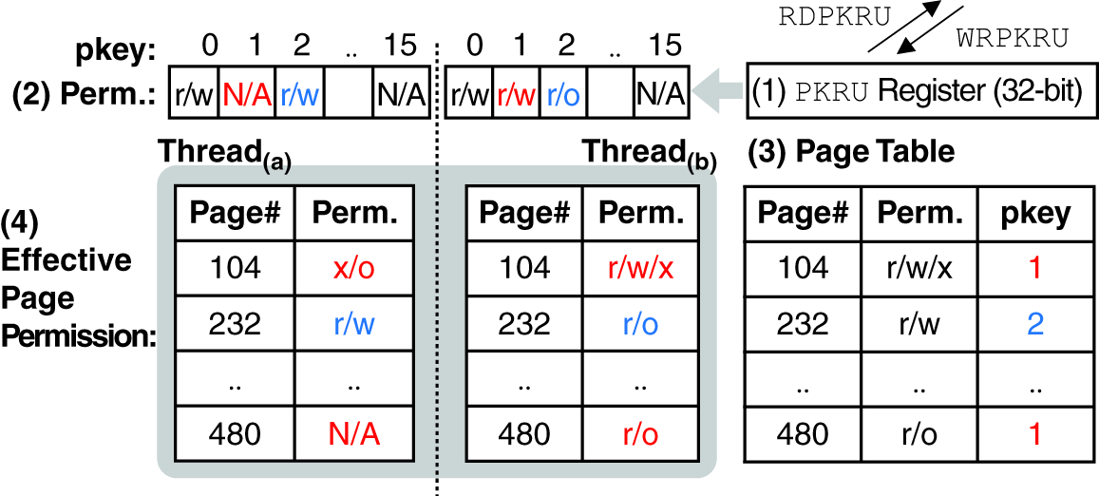
Example: Intel PKU
S. Park, S. Lee and T. Kim, "Memory Protection Keys: Facts, Key Extension Perspectives, and Discussions" in IEEE Security & Privacy, vol. 21, no. 03, pp. 8-15, May-June 2023

Slide 68
Example: Intel PKU
S. Park, S. Lee and T. Kim, "Memory Protection Keys: Facts, Key Extension Perspectives, and Discussions" in IEEE Security & Privacy, vol. 21, no. 03, pp. 8-15, May-June 2023

Slide 69
Example: Intel PKU
S. Park, S. Lee and T. Kim, "Memory Protection Keys: Facts, Key Extension Perspectives, and Discussions" in IEEE Security & Privacy, vol. 21, no. 03, pp. 8-15, May-June 2023

Slide 70
Example: Intel PKU
(~260 cycles)
S. Park, S. Lee and T. Kim, "Memory Protection Keys: Facts, Key Extension Perspectives, and Discussions" in IEEE Security & Privacy, vol. 21, no. 03, pp. 8-15, May-June 2023

Slide 71



Need for Trust in Cloud
Cloud computing hosts critical services in finance, government, healthcare
Yet, cloud services are constantly under attack
and require complete customer trust
*IBM, Cost of a Data Breach Report 2025

Slide 72

Trusted Execution
Re-establish trust in the cloud through software/hardware techniques
Sensitive Computation
X
Malicious App
deploy
X
Runtime Isolation
Privilege software
Cloud Users
Trust establishment
Root of trust

Slide 73
Existing Approaches: Ref. Monitor
Process Memory space
X
Crypto
Math
Network
Math
Util
In-process domains
system calls
Files
Sockets
Memory
Mappings
Operating System

Slide 74
Existing Approaches: Ref. Monitor
Process Memory space
Reference
Monitor
X
Access Control List
Crypto
Math
Network
Math
Util
In-process domains
Intercept
system calls
X
Authorize
Files
Sockets
Memory
Mappings
Operating System

Slide 75
Memory Tagging Extension (MTE)
Tagging of 16B pointers and memory
Only allow accesses when pointer’s and memory’s tags match

Slide 76

PA + MTE
PA and MTE can be simultaneously enabled
Authenticated and tagged pointers resemble capability-based access control!

Slide 77
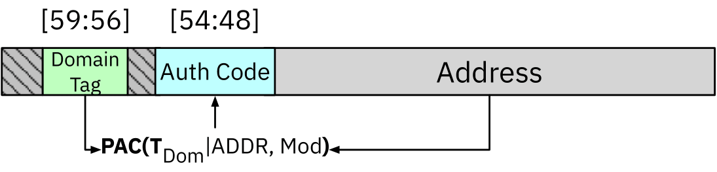
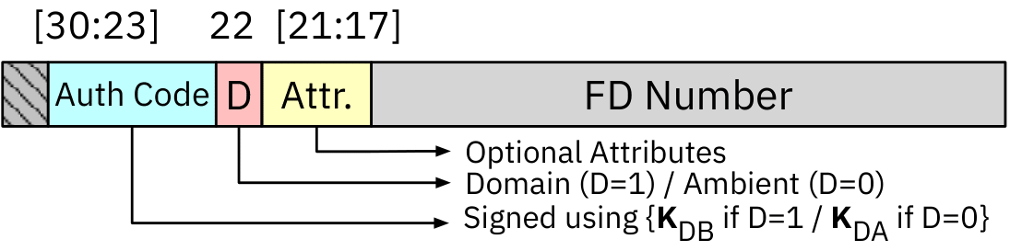
Capacity References
Memory References (Pointers)
System References (File descriptors)

Slide 78
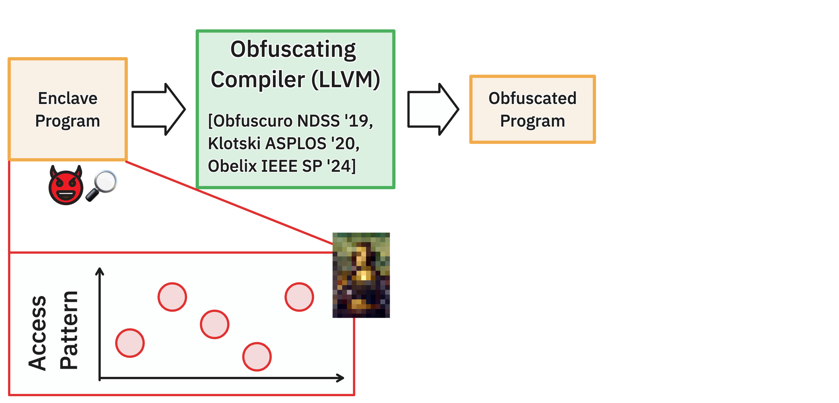
Existing Defense: Obfuscation

Slide 79
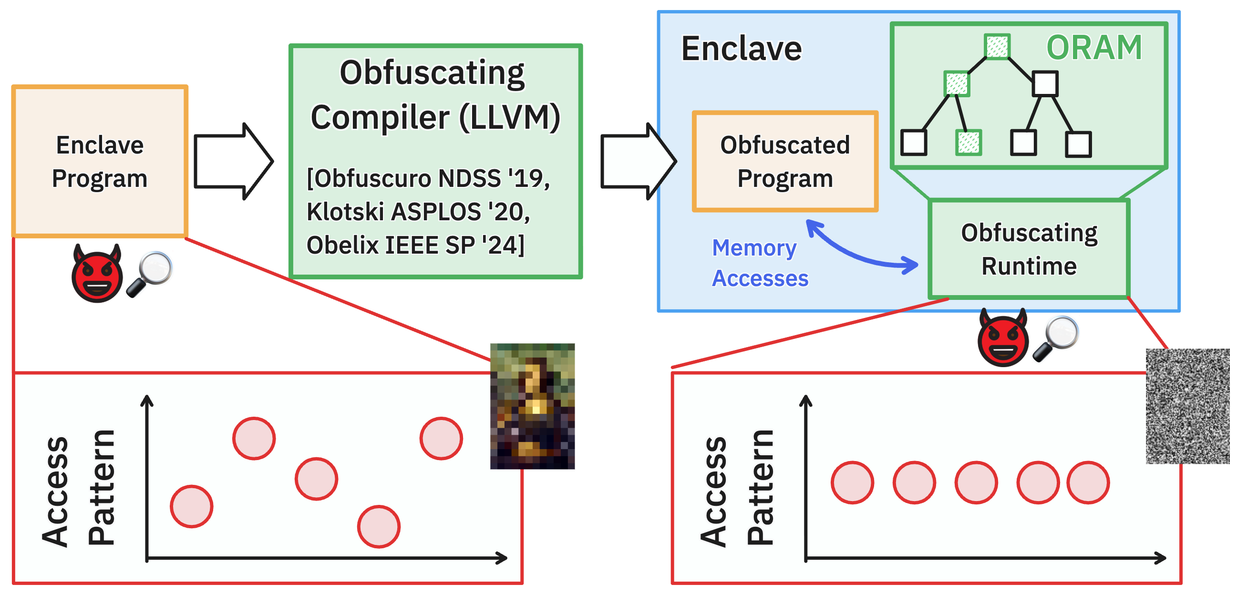
Existing Defense: Obfuscation

Slide 80
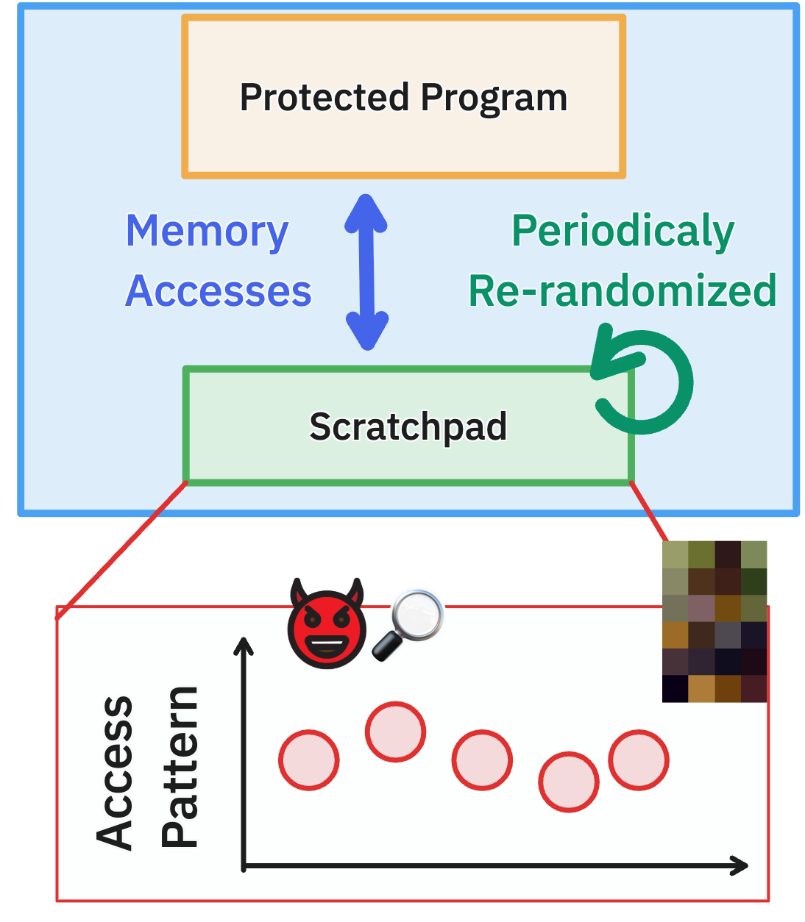
Existing Defense: Periodic Rerand.
Strict obfuscation policies introduce prohibitively high overheads
Periodic re-randomization policies render obfuscation practical

Slide 81
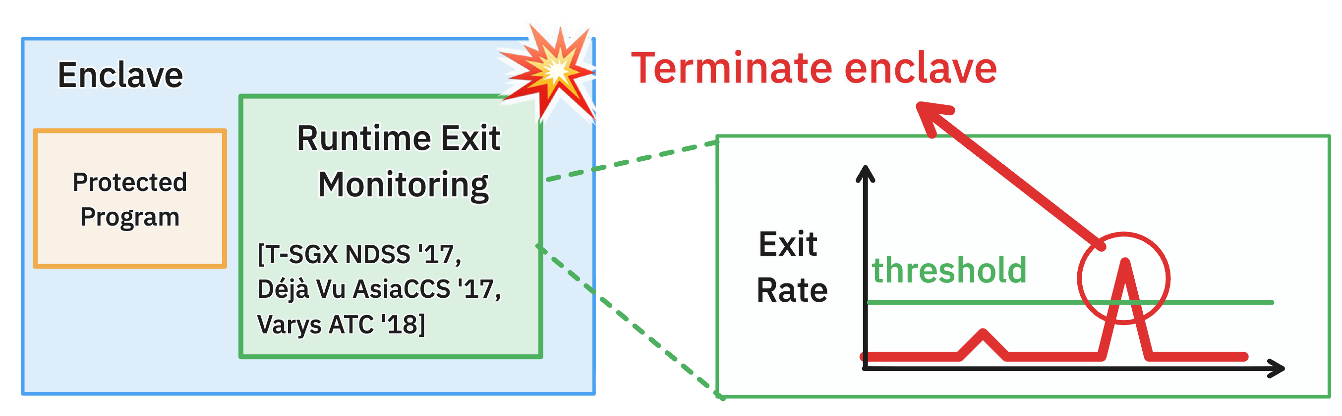
Existing Defense: Threshold-based
Observation: Most SGX attacks rely on frequent enclave exits (AEXs) (e.g., timer interrupts, page faults)

Slide 82
Challenge for CVM Obfuscation
Support for full-VM protection (guest OS + application) remains unsolved
Potential high overheads with user + kernel obfuscation

Slide 83
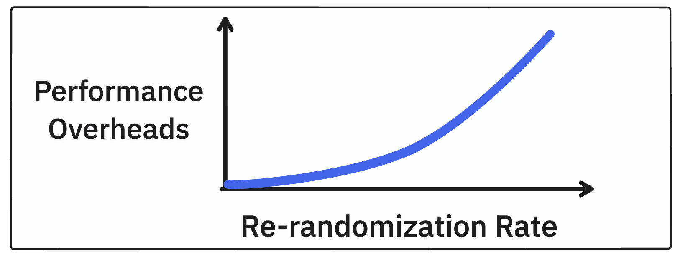
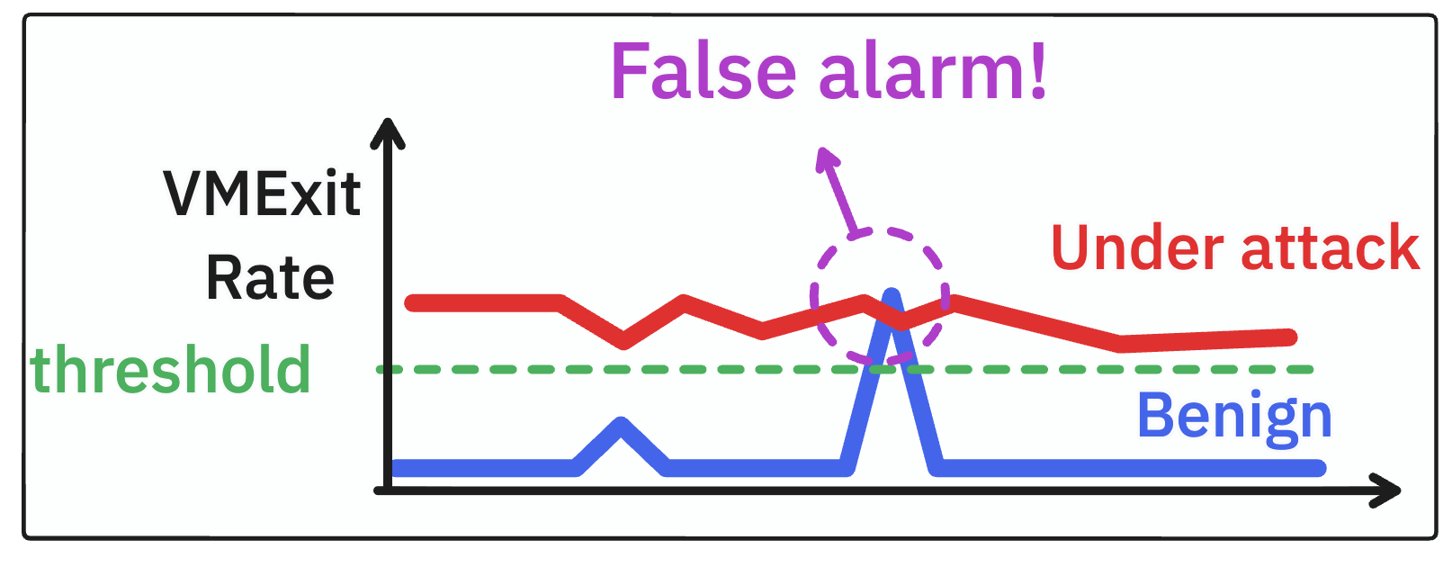
Policy Limitations
Fix-rate
Re-randomization
Threshold-based
Termination
Inherent tradeoffs between security and performance
False-alarm under normal CVM workloads

Slide 84
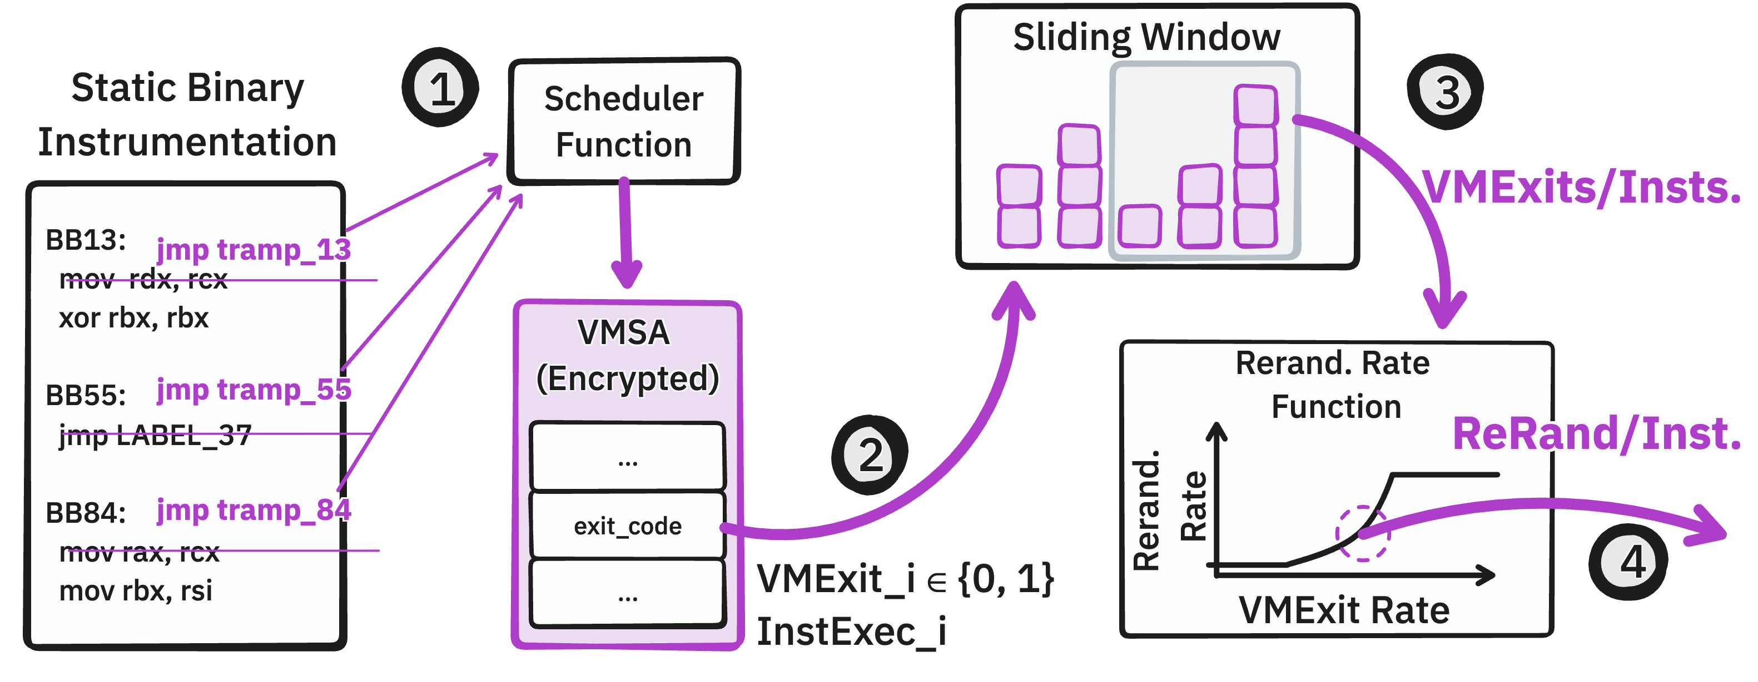
Scheduling Subsystem

Slide 85
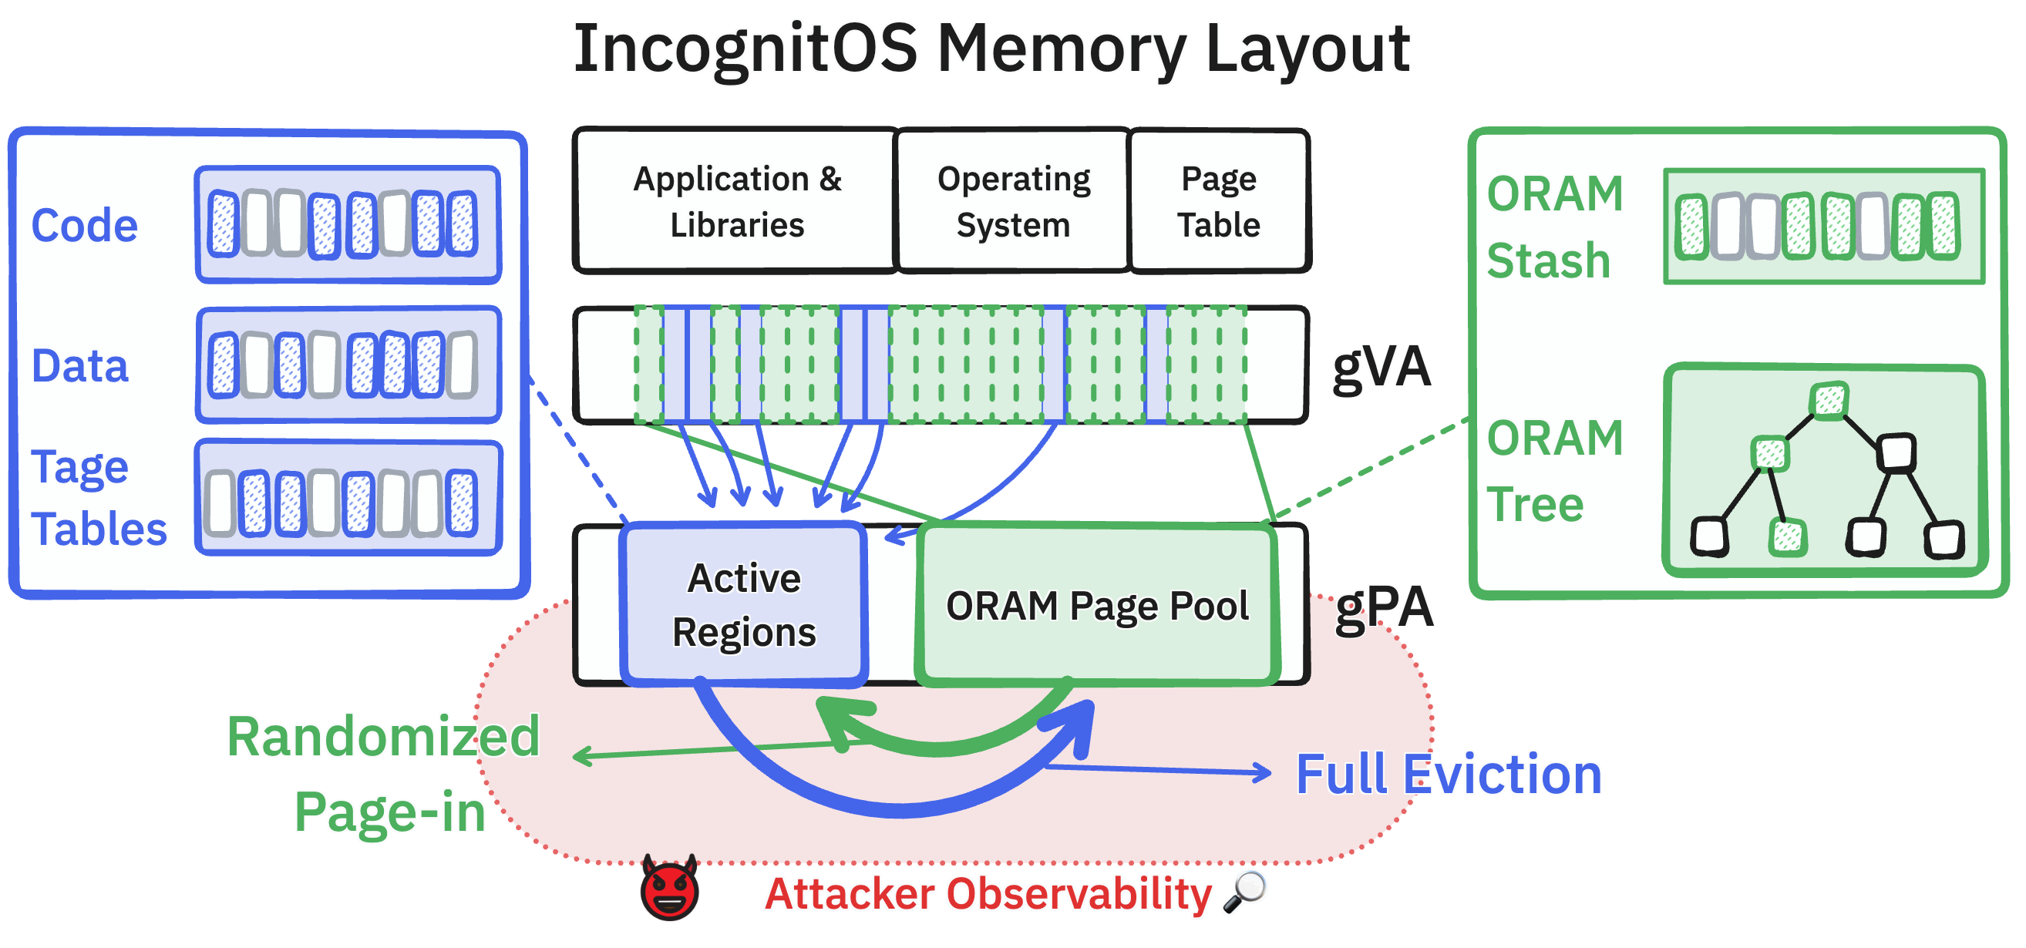
Paging Subsystem

Slide 86
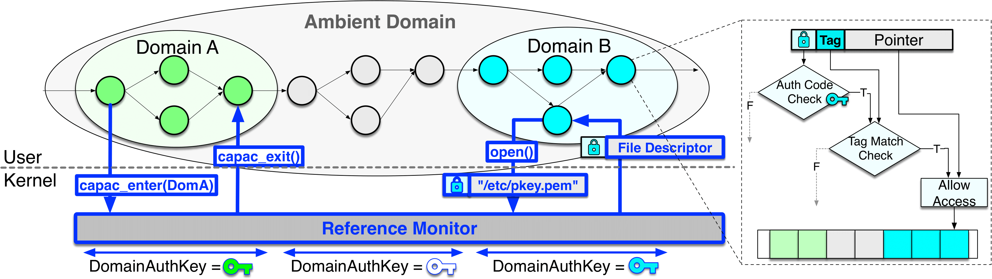
Implementing Capacity
In-kernel Reference monitor authenticates and signs all system resource references (file descriptors and file paths)

Slide 87
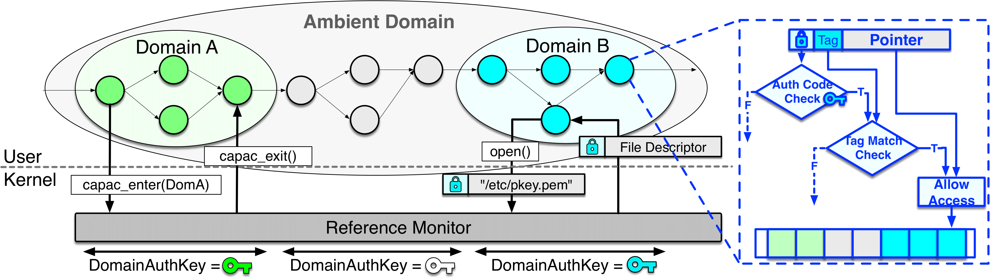
Implementing Capacity
Compiler instrumentation & memory allocator authenticate and sign all userspace memory references, and also tag all memory and pointers (MTE)

Slide 88
Limitations of OS Protection
OS-provided protection is no longer sufficient in the modern age
Individual programs are increasingly complicated → need for fine-grained isolation
Trust crisis in the cloud → need to rethink system trust model

Slide 89
Modern Layers of Protection
System Protection
Goals
HW-defined
Protection
OS Protection
In-process memory isolation establishes protection domains within OS processes

Slide 90
Modern Layers of Protection
System Protection
Goals
HW-defined
Protection
OS Protection
Confidential Virtual Machines bring OSes into hardware protection

